Slide 1
Human Energy Systems
Lesson 2 Activity 2
Notes:
Intro to Lesson 1 Activity 4. Have students share their answers with the class. Remember: atoms last forever!

Slide 2
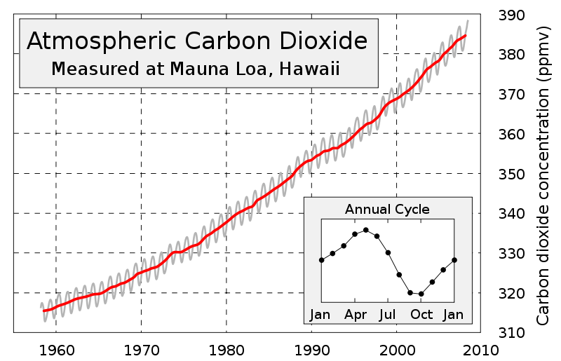
The Keeling Curve
Who can explain the seasonal cycle?
Notes:
Ask students who can share ideas about why atmospheric carbon goes up in the winter and down in the summer.

Slide 3
2. The Carbon/Movement Question
How are the Pools Getting Larger or smaller?
What makes carbon move from one pool to another?
Notes:
Now that we know that carbon goes up in the winter and down in the summer, we want to figure out why this happens.
Ask students to think about how photosynthesis and cellular respiration affect pool sizes. Invite them to explain how this relates to the seasonal trend in the Keeling Curve.

Slide 4
The Carbon/Movement Question
How do carbon-transforming Processes move carbon from one pool to another?
Answer the question for each carbon transforming process
Photosynthesis
Cellular Respiration
Notes:
Ask students to think about how photosynthesis and cellular respiration affect pool sizes. Invite them to explain how this relates to the seasonal trend in the Keeling Curve. If you need to, revisit the image of the Keeling curve on slide 10. Use slides 15-18 to ask questions about photosynthesis and respiration. Invite students to suggest how carbon moves as a result of these carbon transforming prossesses.

Slide 5
Question:
Which pools get larger and smaller during winter and summer?
Atmosphere
CO₂
Biomass
organic carbon
Soil
organic carbon
Fossil Fuels
organic carbon
Notes:
Explain Round 1 using this slide
In the summer, the atmosphere pool gets smaller and the biomass pool gets larger.

Slide 6
Atmosphere
CO₂
Biomass
organic carbon
Question:
Which carbon-transforming processes cause these changes?
Soil
organic carbon
Fossil Fuels
organic carbon
Notes:
PHOTOSYNTHESIS AND CELLULAR RESPIRATION

Slide 7
Atmosphere
CO₂
Biomass
organic carbon
Question:
How does Photosynthesis affect the pools?
Soil
organic carbon
Fossil Fuels
organic carbon
Notes:
Photosynthesis sequesters carbon from the CO₂ in the atmosphere, turning it into biomass.

Slide 8
Atmosphere
CO₂
Biomass
organic carbon
Question:
How does Cellular Respiration affect the pools?
Soil
organic carbon
Fossil Fuels
organic carbon
Notes:
Cellular respiration turns organic carbon (biomass, glucose) back into inorganic carbon (CO₂) and returns it to the atmosphere pool.

Slide 9
Round 1 Student Instructions:
Divide into groups.
Read your scenario card.
Discuss with your group what will happen to the organic and inorganic pools of carbon according to the scenario on your card.
Share your scenarios with the rest of the class (you can use the diagram to help explain if you need to).
Atmosphere
CO₂ (inorganic carbon)
Biomass
organic carbon
Soil
organic carbon
Fossil Fuels
organic carbon
Notes:
Cellular respiration turns organic carbon (biomass, glucose) back into inorganic carbon (CO₂) and returns it to the atmosphere pool.

Slide 10



Energy in the Biomass pool
How does energy enter the biomass pool? (remember rule #3: Energy flows! Energy can never be created or destroyed. It has to come from somewhere).
Through the process of photosynthesis, plants absorb sunlight energy and sequester it in C-C and C-H bonds of sugar molecules. This energy may be stored in the plant, or may be eaten by an animal. This is how energy enters the biomass pool.

Slide 11



Energy in the Atmosphere pool
How does chemical energy leave the biomass pool and enter the atmosphere pool?
Plants, animals and decomposers do cellular respiration for all of their life processes. During cellular respiration, organic molecules like sugar are broken. High energy bonds in sugar (C-C and C-H) are replaced by low energy bonds (C-O and H-O) and the chemical energy is released. This energy can be transformed into:
motion energy or
heat energy (released into
the atmosphere and never
used again).

Slide 12

Where does the energy go?
When the energy leaves the biomass pool and enters the atmosphere pool, what happens to it? (Remember, energy can never be created or destroyed. It has to go somehwere).
Heat energy is lost from the biomass (and eventually radiates into outer space). Some of this heat energy is trapped in greenhouse gases and remains in the atmosphere. Most of this heat radiates back into outer space.
As our greenhouse gases increase, more of this heat is trapped in the atmosphere, causing the global temperatures to rise.

Slide 13
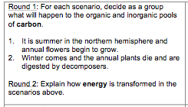
Round 2 Student Instructions:
Stay in the same groups.
Discuss with your group how energy is transformed during the scenario on the same card you used in round 1.
Share your scenarios with the rest of the class.

